Slide 1
SAINTS IN HEAVEN
REVELATION 21:1 – 22:5

Slide 2
REVELATION 21 -22
ENCOURAGED ALL WHO READ IN EVERY GENERATION

Slide 3
WHAT JOHN PREVIOUS HAD SHOWN:
INTENSE TRIBULATION WOULD COME (2:10, 13; 3:10; 6:9-11; 18:24)
FIDELITY TO CHRIST BRINGS ETERNAL LIFE (2:10; 14:13; 20:4, 6)
THE REAL CAUSE FOR THEIR ADVERSITY WAS SATAN (12-13)
BEAST & FALSE PROPHET DESTROYED (19:20, 21)
SATAN BOUND AND THEN LATER ETERNALLY DESTROYED (20:1-10)
JUDGMENT SEAT OF CHRIST (20:11-15)

Slide 4
BY INSPIRATION
JOHN WRITES THE END OF REVELATION
JOHN GIVES A CONCLUSION TO THE BIBLE, HEAVEN’S BOOK
THE ETERNAL REWARD OF THE RIGHTEOUS IDENTIFIED AS:
  FELLOWSHIP WITH GOD (21:1-7)
  PROTECTION BY GOD (21:8-27)
  PROVISION FROM GOD (22:1-5)

Slide 5
APPROACHES:
A NEW ORDER OF THE CHURCH ON EARTH (IN THIS LIFETIME)
  A WRONG APPROACH!
A DESCRIPTION OF HEAVEN & THE SAINTS IN HEAVEN

Slide 6
FELLOWSHIP WITH GOD
REVELATION 21:1-7

Slide 7
NEW HEAVEN & EARTH (21:1)
CANNOT COEXIST WITH THE FORMER
  “FIRST” PASSED AWAY
JESUS TAUGHT THAT SUCH WOULD PASS AWAY
  MATTHEW 24:35
  metaphorically, to pass away or perish (Strong’s 3928; cf. Matt. 24:34)

Slide 8
NEW HEAVEN & EARTH (21:1)
“first” heaven & earth passed away at the judgment (20:11)
POINT: there is still a place that is appropriate for Christians to dwell in
(1 Cor. 15:35, 42-44; Jn. 14:2)

Slide 9
NEW HEAVEN & EARTH (21:1)
2 ways used in Scripture
  ONE, of a new order in this life
  (Is. 65:17ff; 66:22)
    perhaps ultimate fulfillment in church
    immediate fulfillment in Israel’s return from Babylon (“new moons,” “Sabbaths,” and “Levites,” 65:21, 23)
    not speaking of heaven (the eternal abode) as infant would die @ 100 yrs.

Slide 10
NEW HEAVEN & EARTH (21:1)
  TWO, the end of the present “material” universe
    2 Peter 3:1-13 (context)
    second coming of Christ (v. 4, 10, 12)
    material creation (v. 5; cf. Gen. 1)
    literally destroyed in Noah’s flood (v. 6)
    that which remains will be destroyed by fire (v. 7)

Slide 11
NEW HEAVEN & EARTH (21:1)
a principle
the new comes after the first
⁴⁶ However, the spiritual is not first, but the natural, and afterward the spiritual. ⁴⁷ The first man was of the earth, made of dust; the second Man is the Lord from heaven. ⁴⁸ As was the man of dust, so also are those who are made of dust; and as is the heavenly Man, so also are those who are heavenly. ⁴⁹ And as we have borne the image of the man of dust, we shall also bear the image of the heavenly Man.
1 Corinthians 15

Slide 12
NEW HEAVEN & EARTH (21:1)
meaning of John’s use is determined by the context
  Isaiah 65, 66 has its own context
  2 Peter 3 has its own context
  Revelation 21, 22 has its own context

Slide 13
NEW HEAVEN & EARTH (21:1)
CONTEXT
  after judgment (20:12)
    LAST JUDGMENT – ALL PEOPLE STANDING BEFORE THRONE
    ALL DEAD WERE RESURRECTED (20:13)
    DEATH & HADES WERE DONE AWAY (20:14)
    WICKED ARE CAST INTO ETERNAL FIRE (20:15)
    EVENTS IN CHAPTER 21 FOLLOW THESE EVENTS (21:1)

Slide 14
NEW HEAVEN & EARTH (21:1)
CONTEXT
  life afterward is devoid of pain, sorrow and death (21:4)
  nothing can enter that defiles (21:27)
    WHEN HAS THIS HAPPED REGARDING THE CHURCH ON EARTH?
    hard to imagine other “ages” for the church on earth to go through when Christ came at the end of the ages (Heb. 9:26)

Slide 15
“NO MORE SEA” (21:1)
not likely “all of humanity which formed the beast that opposed the church” (13:1)
may be the sea of glass that separated God from the people (4:6)
likely the literal sea from the immediate context (20:13)
  the world was originally a universal ocean, but in this time, there are no seas (cf. Gen. 1:2)

Slide 16
HOLY CITY, NEW JERUSALEM (21:2)
the church in her heavenly state
  prepared as a bride
  the bride, the Lamb’s wife (v. 9)
    shown the great city, the holy Jerusalem (v. 10)
  persecuted under Gentiles (11:2)
    now descends out of heaven

Slide 17
HOLY CITY, NEW JERUSALEM (21:2)
“coming down out of heaven”
  The old Jerusalem had already passed away over 20 years earlier from this writing
  Church = Jerusalem from above (Gal. 4:25, 26)
  “the people” of the church as well as OT saints are already registered in heaven (Phil. 3:20; Heb. 12:23; cf. Book of Life, 20:15; Phil. 4:3)
  Cannot descend to old earth as it has passed away
  Meaning is not so much direction but the origin of the place—from heaven—from God!

Slide 18
The Kingdom
Two-Story
Concept
Matthew
16:19
Church in Heaven
2 Timothy 4:18
Mark 9:43-48
1 Cor. 15:50
Church on Earth
Revelation 11:19
Colossians 1:13, 18
Mark 9:1
John 3:3, 5
Revelation 11:1, 2

Slide 19
Hebrews 11:10, 14-16
10 “for he [Abraham, sjw] waited for the city which has foundations, whose builder and maker is God. . . 14 For those who say such things declare plainly that they seek a homeland. 15 And truly if they had called to mind that country from which they had come out, they would have had opportunity to return. 16 But now they desire a better, that is, a heavenly country. Therefore God is not ashamed to be called their God, for He has prepared a city for them.”

Slide 20
1 Peter 1:3-5
“Blessed be the God and Father of our Lord Jesus Christ, who according to His abundant mercy has begotten us again to a living hope through the resurrection of Jesus Christ from the dead, to an inheritance incorruptible and undefiled and that does not fade away,
reserved in heaven for you, who are kept by the power of God through faith for salvation ready to be revealed in the last time.”

Slide 21
TABERNACLE FILLED WITH MEN (21:3)
“TABERNACLE” USED OF VARIOUS THINGS IN THE BIBLE
  TENT THAT MOSES ERECTED (Heb. 8:5)
  JESUS’ BODY OF FLESH (Jn. 1:14; 2:21)
  THE CHURCH (Acts 15:16, 17; Eph. 2:19ff)
    OT Holy Place—possibly sym. of the Church
    OT Most Holy Place—sym of Heaven (cf. Heb. 8:1, 2; 9:11, 12, yet entered into heaven: 9:23, 24)

Slide 22
TABERNACLE FILLED WITH MEN (21:3)
“DWELLING”
  “and I heard a loud voice from the throne saying, ‘Behold, the dwelling of God is with men. He will dwell with them, and they shall be his people, and God himself will be with them’” (RSV)

Slide 23
21:3
FULL FELLOWSHIP WITH GOD
  IN THE GARDEN THEN LOST
  PARTIALLY REALIZED WHEN MOSES BUILT THE TABERNACLE
  TEMPORARILY REALIZED WHEN JESUS CAME IN THE FLESH (Jn. 1:14)
  SPIRITUALLY REALIZED IN THE CHURCH WHERE GOD DWELLS IN OUR HEART BY FAITH (Eph. 2:19-22; 3:17)

Slide 24
21:3
FELLOWSHIP
  JOHN SEES WHERE FELLOWSHIP WITH GOD IS PERMANENTLY REALIZED
  GOD IS HERE PRESENTED AS “IMMANUEL” (GOD WITH US) AS WAS PREVIOUSLY TRUE OF THE LAMB (Matt. 1:23)
    God is “with” (Gk. meta) not “in” (Gk. en) man (cf. 1 Cor. 6:19)
    God is the temple, not man (21:22)
    “we shall see Him as He is” (I Jn. 3:2)

Slide 25
21:3
NOTE: if you understand Revelation 21 to be of the church in another era ‘on this earth,’ how would this be true of the church post-Rome and not be true of the church during Rome’s rule?
  How is God “with” man today in the church that He was not “with” man during the days of Rome?

Slide 26
WIPE AWAY EVERY TEAR (21:4)
WHEN GOD WIPES AWAY, HE OBLITERATES
  SAME WORD USED OF THE LAW (COL. 2:14)
  SAME WORD USED OF SIN (ACTS 3:19)
THIS IS THE PICTURE OF THE FATHER TAKING CARE OF HIS CHILDREN

Slide 27
NO MORE DEATH (21:4)
DEATH CAME BY MAN
(GEN. 3:1ff; 1 COR. 15:21)
“SEPARATION” (JAS. 2:26)
  SIN SEPARATES FROM GOD (IS. 59:2)
JOHN DESCRIBES A DAY WHEN OBITUARIES ARE PUT TO DEATH
  “So when this corruptible has put on incorruption, and this mortal has put on immortality, then shall be brought to pass the saying that is written: ‘Death is swallowed up in victory’” (1 Cor. 15:54)

Slide 28
FORMER THINGS (21:4)
WILL PASS AWAY
ARE AT WORK IN THIS WORLD
  ALL CAME BECAUSE OF THE CURSE
  YET, JOHN DESCRIBES A PLACE WITH NO CURSE (22:3)

Slide 29
MAKES ALL THINGS NEW
(21:5, 6)
MADE US NEW “IN CHRIST”
(2 Cor. 5:17)
IN HEAVEN “ALL THINGS” ARE NEW

Slide 30
WRITE (21:5, 6)
JOHN IS TO WRITE THESE THINGS DOWN BECAUSE THEY ARE TRUE & FAITHFUL
GOD KEEPS HIS WORD
  HE IS THE BEGINNING AND END
    USED OF CHRIST IN 1:11, 17
  HE WAS IN THE BEGINNING OF CREATION AND WILL BE THERE IN ITS PASSING

Slide 31
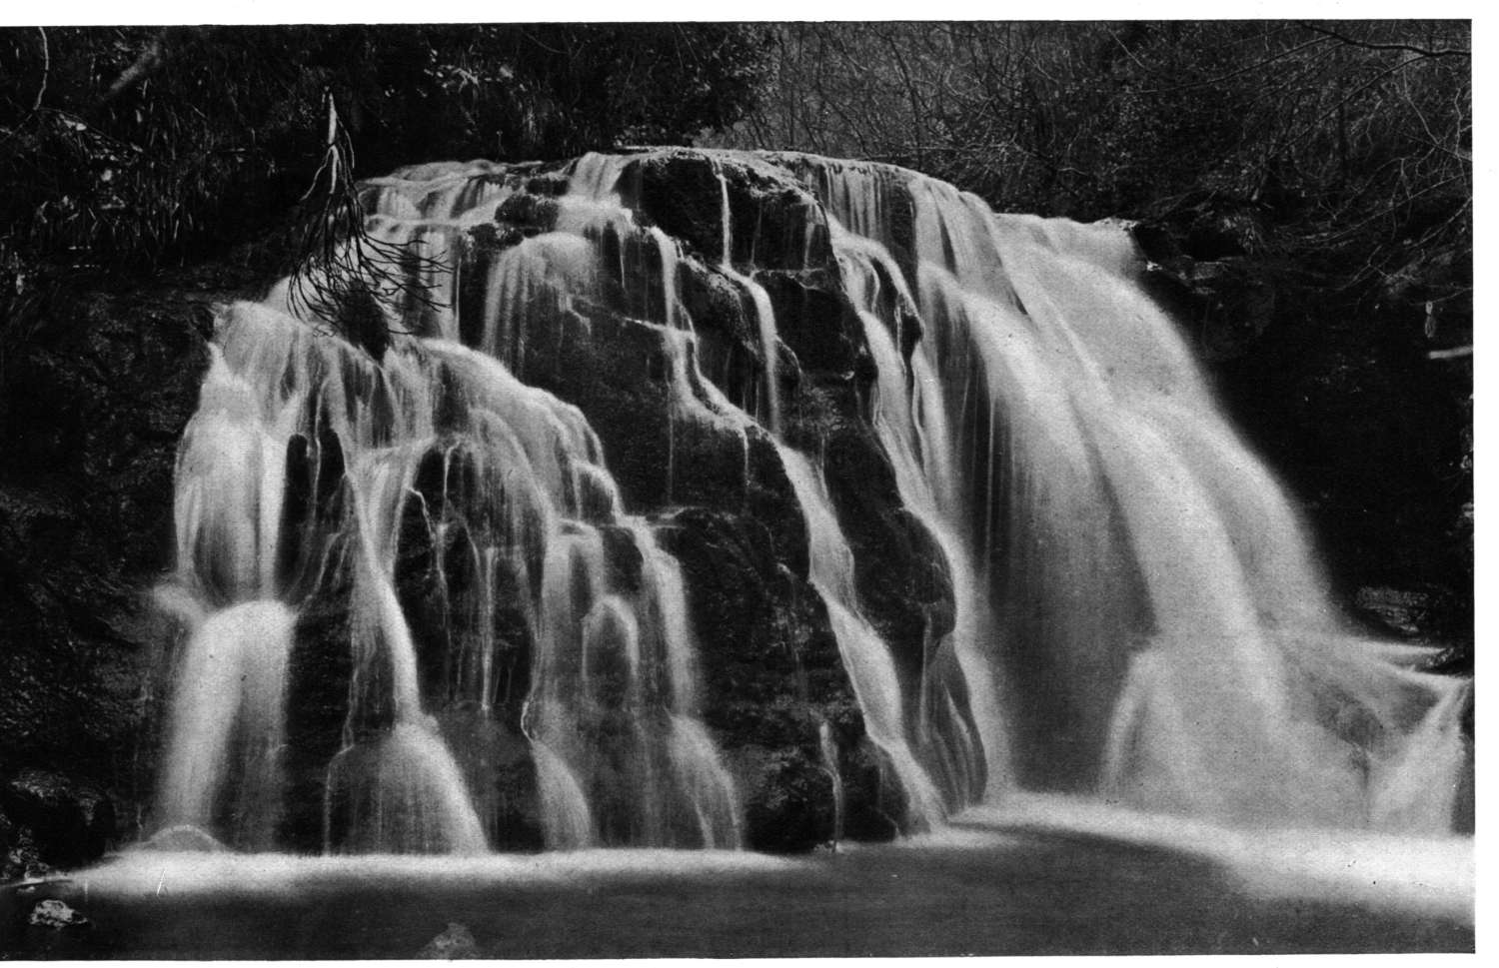
I WILL GIVE OF THE FOUNTAIN (21:6)
HE IS THE SOURCE OF ALL LIFE
MAN SHOULD PANT AFTER HIM AS A DEER WOULD THE WATER BROOKS (Ps. 42:1)

Slide 32
HE WHO OVERCOMES (21:7)
EXPRESSION IS THEMATIC OF THE BOOK
  WAS GIVEN TO EACH CHURCH (2:7, 11, 17, 26; 3:5, 12, 21)
  REVELATION IS ABOUT OVERCOMING SATAN AND HIS ALLIES

Slide 33
PROTECTION BY GOD
REVELATION 21:8-27

Slide 34
21:8
THESE ARE THE “REST” OF HUMANITY - THE WICKED
  REVELATION SHOWS TWO KINDS OF PEOPLE
    THOSE WHO OVERCOME IN THE FIRST RESURRECTION: those sealed with God
    AND THE “REST OF THE DEAD”: those overcome with Satan

Slide 35
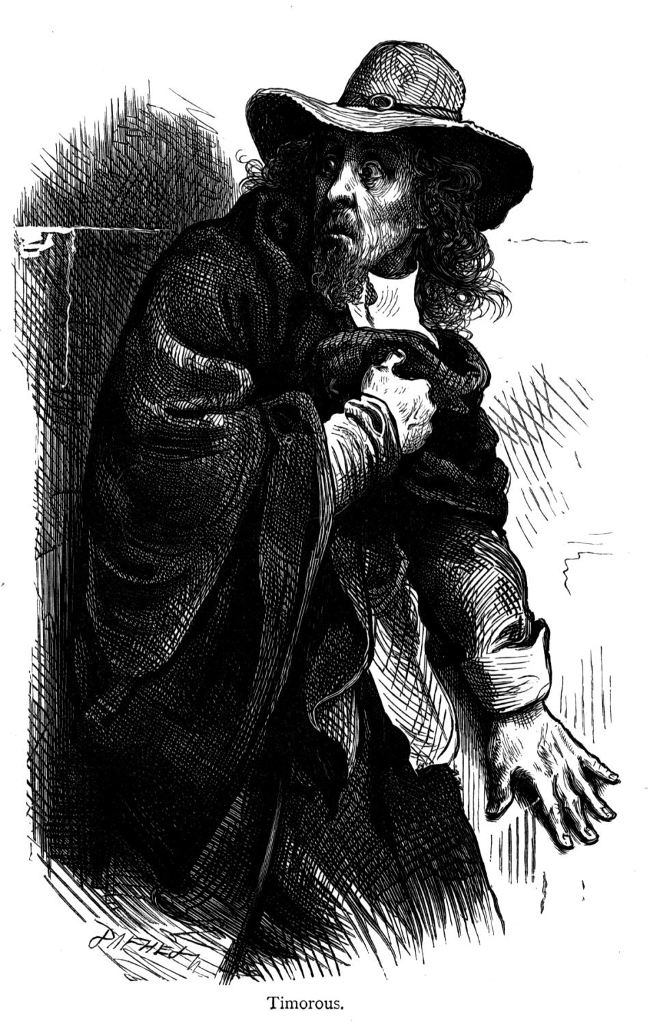
21:8
“COWARDLY”
  “FEARFUL” (KJV)
  TOO TIMID TO STAND
  SHRINKS BACK FROM CONFLICT THAT IS ASSOCIATED WITH THE WHOLE COUNSEL

Slide 36
21:8
“UNBELIEVING”
  “UNSTEDFAST” (YLT)
  FALLEN AWAY CHRISTIANS (HEB. 3:12)
  ALSO THOSE WHO HAVE NEVER BELIEVED AND REJECTED THE GOSPEL
  ONE CAN BE “MORAL” YET STILL BE “UNBELIEVING”

Slide 37
21:8
“ABOMINABLE”
  “THE POLLUTED” (RSV)
  “THOSE HAVING BECOME FOUL” (GREEN’S LIT. TRANSLATION)
“MURDERERS”
  UNLAWFUL SHEDDING OF BLOOD
  INNOCENT BLOOD (PROV. 6:17)
  WILL NOT INHERIT THE KINGDOM
  (GAL. 5:19-21)

Slide 38
21:8
“SEXUALLY IMMORAL”
  FORNICATORS (KJV)
  PROSTITUTE TO FULFILL THE SEXUAL DESIRE OUTSIDE OF LAWFUL MARRIAGE
  HEBREWS 13:4, “Marriage is honorable among all, and the bed undefiled; but fornicators and adulterers God will judge.”

Slide 39
21:8
“SORCERERS”
  (Gk. farmakeusin) – one who prepares and uses magical remedies, drugs, etc.
“IDOLATERS”
  those who replace devotion to the Creator with some other person or thing.
“ALL LIARS”

Slide 40
21:8
When contemplating on this passage, one’s mind should give special attention to how horrible the place of hell is as well as the company!

Slide 41
21:9, 10
PERMITTED TO SEE THE LAMB’S WIFE BY ONE OF THE SEVEN ANGELS (cf. 15:1)
  marriage was alluded to in 19:7-9
  dressed in righteous acts
  this woman is in contrast to the whore in 17:1ff
  “I will show you the bride” … “showed me the great city, the holy Jerusalem”

Slide 42
21:9, 10
TAKEN TO A GREAT AND TALL MOUNTAIN
  A GREAT VANTAGE POINT TO SEE THE CITY
  SHOWING THE “PRESENTING” OF THE BRIDE TO HUSBAND (cf. 2 COR. 11:2; EPH. 5:27)
  “Blessed are those who are called to the marriage supper of the Lamb!” (19:9)

Slide 43
21:9, 10
DESCENDS OUT OF ‘HEAVEN’ FROM ‘GOD’
  SHE IS HEAVENLY
  SHE IS THE KINGDOM OF ‘HEAVEN’ AND OF ‘GOD’

Slide 44
MATTHEW 19:23, 24
“Then Jesus said to His disciples, ‘Assuredly, I say to you that it is hard for a rich man to enter the kingdom of heaven. And again I say to you, it is easier for a camel to go through the eye of a needle than for a rich man to enter the kingdom of God.”

Slide 45
21:9, 10
DESCENDS OUT OF ‘HEAVEN’ FROM ‘GOD’
  THE GOSPEL PLAN, THE CHURCH, AND ALL THAT JESUS DID ORIGINATED IN HEAVEN (EPH. 3:10, 11)
  CITIZENSHIP IS IN HEAVEN (PHIL. 3:20)
  IN CHRIST WE SIT IN “HEAVENLY PLACES” (EPH. 2:6)

Slide 46
AN OBSERVATION
A FAIR ASSUMPTION TO SEE THE DESCRIPTIONS FIT THE SAVED IN HEAVEN WITH THE HEAVENLY PLACE ITSELF
  SHE DESCENDS FROM GOD, HAVING THE GLORY OF GOD
  THE “GLORY” THAT DESCRIBES THE SAVED ALSO DESCRIBES GOD
  DESCENDS FROM HEAVEN AND YET SHOWS CHARACTERISTICS OF HEAVEN

Slide 47
21:11 “HER LIGHT”
LIKE A MOST PRECIOUS STONE
  NOT A STONE, BUT “LIKE” ONE, JASPER
  CLEAR AS CRYSTAL
  SINCE SHE BEARS THE GLORY OF GOD, HER JASPER-LIGHT IS LIKE GOD (SEE 4:3)
  OUR LIGHT MUST BE AS CLEAR AS GOD’S
    HE GIVES LIGHT (22:5)
    “. . .light dwells with Him” (Dan. 2:22)
    HIS “. . . judgments are like light that goes forth” (Hos. 6:5)

Slide 48
21:12, 13
great and high wall
  walls were formed for protection from enemies
  this wall is unassailable for sin to enter (21:27)

Slide 49
21:12, 13
12 gates
  a city’s gate was the entrance
  “twelve” carries with it the idea of “religion,” “God’s covenant people”
  there is an abundant entrance into the city for those who lived and died for God’s covenant
  12 angels signify protection

Slide 50
21:12, 13
12 gates
  names of the twelve tribes of Israel written on the gates
  may represent the saved of the OT order (Heb. 9:15; 11:10, 13ff)
  or simply the “spiritual Israel”
4 sided city (v. 13)
  “four” signifies “whole”

Slide 51
“Four” = “Whole”
4
corners of house
(Job 1: 19)
corners of earth
(Is. 11:12; Rev. 7:1; 20:8)
corners of land
(Ezek. 7:2)
the significance of the city’s description is that people from the north, south, east and west would come into the kingdom (7:9)

Slide 52
21:14
TWELVE FOUNDATIONS
12 gates into the city
12 foundations for the wall
  apostles’ names inscribe on them, would include NT Saints
  apostolic doctrine is what keeps the church pure and protected from sin

Slide 53
Observation:
IF THE APOSTLES’ NAMES ARE INSCRIBED IN THIS FOUNDATION, WHAT DOES IT TELL YOU ABOUT CHURCHES WHO NEITHER RESPECT NOR OPERATE INSIDE OF APOSTOLIC DOCTRINE?
WILL THEY EXIST IN HEAVEN?
EPHESIANS 2:
19 Now, therefore, you are no longer strangers and foreigners, but fellow citizens with the saints and members of the household of God,
20 having been built on the foundation of the apostles and prophets, Jesus Christ Himself being the chief cornerstone

Slide 54
Verses 15, 16
(measuring the city)
“gold reed” or “measuring rod” (RSV)
  “gold” suggests a pure standard
  measuring ensures perfection of provision, entrance and security
  12 thousand furlongs = 1380 miles (marg. ref. NKJV)
    Twelve = God’s people
      3 (deity) X 4 (creation)
    Thousand = multiplied completeness (10X10X10)

Slide 55
Verse 17
(measuring the wall)
144 cubits by man’s measurements
  “seventy-two yards, according to human measurements, which are also angelic measurements” (NASB)
  “. . .which the angel was using” (NRSV)
  144 = 12X12
  the wall is sufficiently secure for the holy Jerusalem

Slide 56
CONSTRUCTION OF WALL (21:18-20)
wall of jasper
foundations adorned with all kinds of precious stones
  the church is made of the best material and it will inherit the best of places
  the church in heaven is set in stark contrast with the place that the unbelieving inherit (v. 8)
city of gold
  possibly that it radiates like pure gold
  Christians are to be a people tried like gold refined in fire (1 Pet. 1:7; Rev. 3:8; Zech. 13:9)

Slide 57

CONSTRUCTION OF GATES (21:21)
Pearls held the highest rank among all precious jewels in the ancient world (Harkrider, p. 247)
  each gate had one large pearl to give added glory to the entrance
  only jewel made from suffering

Slide 58
CONSTRUCTION OF GATES (21:21)
Ro 11:33, “Oh, the depth of the riches both of the wisdom and knowledge of God! How unsearchable are His judgments and His ways past finding out!”
Ephesians 2:6-7, “and raised us up together, and made us sit together in the heavenly places in Christ Jesus, that in the ages to come He might show the exceeding riches of His grace in His kindness toward us in Christ Jesus.”

Slide 59
21:22 No Temple
OT temple overlaid with gold
  New Jerusalem is a city of gold
Lord God and Lamb are temple
  transitional from the present state of the church

Slide 60
21:22
The present temple
  1 Corinthians 3
  ¹⁶ Do you not know that you are the temple of God and that the Spirit of God dwells in you? ¹⁷ If anyone defiles the temple of God, God will destroy him. For the temple of God is holy, which temple you are.

Slide 61
21:22
The present temple
  Ephesians 2
  ²¹ in whom the whole building, being joined together, grows into a holy temple in the Lord, ²² in whom you also are being built together for a dwelling place of God in the Spirit.
  A DWELLING PLACE OF GOD “IN THE SPIRIT”

Slide 62
GOD’S DWELLING PLACE
SOLOMON’S TEMPLE – TEMPORARY
CHURCH – SPIRITUALLY
HEAVEN – GOD’S PERMANENT DWELLING PLACE

Slide 63
GOD’S PERSON DWELLS IN HEAVEN
1 Kin. 8:30, 39, 43, 49; 2 Chron. 30:27; Is. 37:16; Acts 17:24; Heb. 8:1
REVELATION 21:22 CANNOT SPEAK OF THE CHURCH “ON EARTH”
  CHURCH ON EARTH IS THE TEMPLE WHERE GOD DWELLS ‘IN’ MAN
  21:22 TEACHES GOD IS THE TEMPLE WHERE MEN DWELL

Slide 64

Verse 23
(no material light bringers)
draws attention to the light
and contrasts it with what
we know to be instruments
of illumination
  the light we get comes from
  the sun, stars, and indirect light
  at night from the moon
  God created these to be useful for terrestrial activity (Gen. 1:14-18)
    for signs, seasons, days and years, etc.

Slide 65
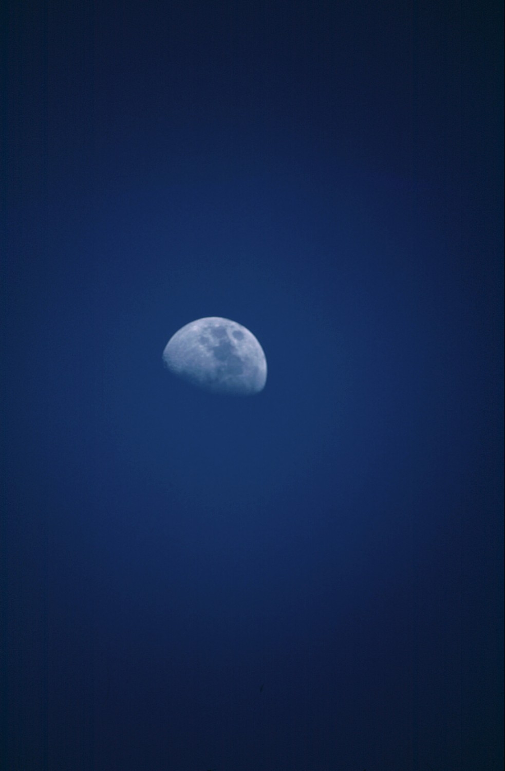
Verse 23
(no material light bringers)
In heaven there is no need for the sun & moon
Light proceeds from the glory of God
  recall that before God created the sun, moon and stars, he created “light” (Gen. 1:3). Light predates the sun!
  “Your sun shall no longer go down, Nor shall your moon withdraw itself; For the LORD will be your everlasting light, And the days of your mourning shall be ended” (Is. 60:20)

Slide 66
Verse 24 – saved of the nations
city is open for the saved of the nations
  those who are not saved are barred from the city (21:8, 27)

Slide 67
Verse 24 – saved of the nations
the religion of Christ has always been for all nations, not simply one
  Psa. 22:27, “All the ends of the world Shall remember and turn to the LORD, And all the families of the nations Shall worship before You.”
  Isa. 2:2, “Now it shall come to pass in the latter days That the mountain of the LORD’S house Shall be established …And all nations shall flow to it.”

Slide 68
Verse 24 – saved of the nations
Isa. 52:15, “So shall He sprinkle many nations. Kings shall shut their mouths at Him; For what had not been told them they shall see, And what they had not heard they shall consider.”
Isa. 55:5, “Surely you shall call a nation you do not know, And nations who do not know you shall run to you…”
Isa. 60:3, “The Gentiles shall come to your light, And kings to the brightness of your rising.”

Slide 69
Verse 24 – saved of the nations
Isa. 60:11 “Therefore your gates shall be open continually; They shall not be shut day or night, That men may bring to you the wealth of the Gentiles, And their kings in procession.”
Jer. 4:2, “And you shall swear, ‘The LORD lives,’ In truth, in judgment, and in righteousness; The nations shall bless themselves in Him, And in Him they shall glory."
Matt. 28:19, "Go therefore and make disciples of all the nations, baptizing them in the name of the Father and of the Son and of the Holy Spirit.”

Slide 70
21:24
The Majority Text reads, “. . .the kings of the earth bring their glory and honor of the nations to Him (marginal reference, NKJV)
  Has happened since Jesus arose and gospel preached
  Whenever men hear and obey the word, they deny self and give themselves to the Lord
  One can look across the nation of America and see the glory and honor that the “saved” bring to Jesus

Slide 71
21:25 – where the gates swing outward never
shows security
  gates are never closed to swing outward because there are no enemies of the church present to threaten
    all enemies have been vanquished to the lake of fire

Slide 72
21:25 – no night
People are more prone to do evil at night
  1 Thessalonians 5:5, You are all sons of light and sons of the day. We are not of the night nor of darkness. ⁶ Therefore let us not sleep, as others do, but let us watch and be sober. ⁷ For those who sleep, sleep at night, and those who get drunk are drunk at night. ⁸ But let us who are of the day be sober, putting on the breastplate of faith and love, and as a helmet the hope of salvation.
  The righteous are never to allow retirement from the light to sleep in darkness

Slide 73
21:26 – bring glory and honor
Majority Text adds, “that they may enter in”
“Those who obey the will of God are the salt of the earth. ‘ Their works do follow them’ (14:13), thus they will bring honor and glory of mankind with them”
(Robert Harkrider)

Slide 74
21:27 – no defilement
emphasizes the separation of sinners from saints
a place devoid of sin

Slide 75
21:27 – no defilement
church on earth?
  sin has penetrated the church on earth
    five of the seven churches of Asia had sin in the camp
    Paul was jealous with godly jealousy for the church on earth (2 Cor. 11:2)
    some would turn disciples away from the truth (Acts 20:28ff)
    overbearing and malicious Diotrophese (3 Jn. 9ff)
    parable of the wedding feast (Matt. 22:11-14); tares (Matt. 13:36-43); dragnet (Matt. 13:48)

Slide 76
21:27
doesn’t make any sense in reference to the church in this life
makes perfect sense in understanding its emblems to refer to the saved in heaven

Slide 77
Additional Reasons For Rejecting this as the church on earth
Doesn’t match chronology
  events in 21 come after the judgment scene (20)
Drinking the water of life occurs simultaneously with those burning in the lake of fire
The former things passed: earth, the heavens, death, sorrow, pain, tears
  how can this be true of the church on earth?

Slide 78
Additional Reasons For Rejecting this as the church on earth
How can the church on earth serve God day and night in His temple which is in heaven (cf. 11:19)
The difference in seeing God’s face (22:4; cf. 1 Jn. 4:12)

Slide 79
Additional Reasons For Rejecting this as the church on earth
God is dwelling “with” men; not “in” man spiritually (21:3; Eph. 3:17; 2 Cor. 1:22)
Saints shall reign forever and ever, but before judgment only 1000 years (22:5)

Slide 80
PROVISIONS FROM GOD
REVELATION 22:1-5

Slide 81
3 Sections
Fellowship
Protection
God & Man
Provision
FELLOWSHIP WITH GOD (21:1-7)
PROTECTION BY GOD (21:8-27)
PROVISIONS FROM GOD (22:1-5)

Slide 82
SYMBOLS OF PARADISE
SYMBOLS & THEMES OF THE EDEN
  RIVERS
  TREE OF LIFE
  NO CURSE
  PRESENCE OF GOD (GEN. 3:8; REV. 22:4)
  SERVICE (GEN. 2:15; REV. 22:3)
  DOMINION (GEN. 1:28; 22:5)

Slide 83
DIFFERENCES BETWEEN THE GENESIS AND REVELATION PARADISE
OF THIS WORLD
  GEN: was part of this world
  REV: world passed away (21:1)
  therefore not of this world

Slide 84
DIFFERENCES BETWEEN THE GENESIS AND REVELATION PARADISE
“DOMINION” AND “LIFE”
  GEN: theoretically eternal—proved to be temporary because of disobedience
  GEN: disobey command→ forfeit blessings; rather than ruling “over” world man fell to the world
    “TO DUST YOU SHALL RETURN” (GEN. 3:19)
  Adam and Eve had tree of life—their continual obedience secured it
  Today: obedience in this life is key to receiving eternal life to come “tree” of life (REV. 22:14)

Slide 85
DIFFERENCES BETWEEN THE GENESIS AND REVELATION PARADISE
GENESIS-PARADISE WAS SUBJECT TO DEFILEMENT
  SATAN ENTERED → DECEIVED → MURDERED (cf. Jn. 8:44)
  NOTHING CAN DEFILE THE REVELATION-PARADISE
    SATAN IS DESTROYED BY THE TIME THE SAVED ENTER (20:10)

Slide 86
PURE RIVER (22:1)
WATER: essential for man’s existence
  THE SYMBOL SHOWS GOD WILL PROVIDE FOR HIS PEOPLE WHAT THEY NEED
  CHARACTERISTICS: PURE & CLEAR
    REASON FOR QUALITY IS ITS FOUNTAINHEAD—THE THRONE OF GOD AND THE LAMB
    GOD IS THE SOURCE: TRUE LIFE FLOWS FROM HIM AND HIS THRONE (1 TIM. 6:15, 16; 1 JN. 1:1, 2)

Slide 87
PURE RIVER (22:1)
“All our springs of grace, comfort, and glory are in God; and all our streams from him are through the mediation of the Lamb.”
Matthew Henry Commentary (Vol. 6, p. 1186)

Slide 88
A TREE OF LIFE (22:2)
“. . .To him who overcomes I will give to eat from the tree of life, which is in the midst of the Paradise of God” (2:7)
  The tree is present because there is no more “curse” (Gen. 3:17; Rev. 22:3)

Slide 89
AMPLIFIED VERSION
“Through the middle of the broadway of the city; also, on either side of the river was the tree of life with its twelve varieties of fruit, yielding each month its fresh crop; and the leaves of the tree were for the healing and the restoration of the nations.”

Slide 90
SIMILAR LANGUAGE
EZEKIEL 47:1-12
  WATER FLOWS FROM UNDERNEATH TEMPLE
  TREES ON BOTH SIDES OF RIVER
  LEAVES WILL NEVER WITHER; FRUIT WILL NOT FAIL
    FRUIT FOR FOOD
    LEAVES FOR MEDICINE

Slide 91
COMPARE ZECHARIAH
“In that day a fountain shall be opened
for the house of David and for the
inhabitants of Jerusalem, for sin and
for uncleanness.” (13:1)
“And in that day it shall be that living
waters shall flow from Jerusalem, half
of them toward the eastern sea and half of them toward the western sea; in both summer and winter it shall occur” (14:8)

Slide 92
COMPARE JESUS
13 Jesus answered and said to her, "Whoever drinks of this water will thirst again,
14 "but whoever drinks of the water that I shall give him will never thirst. But the water that I shall give him will become in him a fountain of water springing up into everlasting life."
JOHN 4

Slide 93
JOHN & EZEKIEL
WHILE IN CAPTIVITY EZEKIEL SPOKE OF ANOTHER TEMPLE WHERE LIVING WATER WOULD FLOW –OF JESUS AND THE CHURCH
  WHILE IN EXILE JOHN SPOKE OF ANOTHER TEMPLE WHERE LIVING WATER FLOWED –BEFORE THE THRONE OF GOD IN HEAVEN

Slide 94
JOHN & EZEKIEL
EZEKIEL AND COMPANY HAD BEEN PLUNDERED AND TAKEN AWAY
  JOHN AND THE CHURCH WERE IN TRIBULATION (REV. 1:9; 11:2)
  MANY WOULD BE PUT TO THE SWORD AND SUFFER DEATH (REV. 2:10; 6:9; 18:24; 20:4)
  LIKE EZEKIEL, JOHN SPEAKS OF ANOTHER TIME IN HUMAN HISTORY—AN ETERNAL DAY WITH GOD ‘AFTER’ THE JUDGMENT

Slide 95
TREE OF LIFE
BORE TWELVE FRUITS
PRODUCES EVERY MONTH
LEAVES FOR HEALING
  Leaves heal because they are on the tree “of life”
  Tree is “of life” because its source is the water “of life”
  Water is “of life” because its source is the throne of God
  All nations healed from sin through gospel (Matt. 28:19)
  Ultimate fulfillment at resurrection when we are restored to walk in the presence of God

Slide 96
NO MORE CURSE (22:3)
THE EFFECTS OF THE CURSE AND THE CURSE ITSELF ARE REMOVED (cf. 21:4)
SATAN IS NOT PRESENT TO DECEIVE
  He is not there to disrupt our service to the Lord as he did the first couple
“HIS SERVANTS SHALL SERVE HIM”
  A place of meaningful activity

Slide 97
THEY SHALL SEE HIS FACE (22:4)
Sought by Moses (Ex. 33:17)
  “You cannot see My face; for no man shall see Me, and live” (v. 20)
  “No one has seen God at any time” (Jn. 1:18a)
1 John 3:1, 2

Slide 98
THERE SHALL BE NO NIGHT (22:5)
ONE ENDLESS DAY WITHOUT BEING INTERRUPTED BY NIGHT
  THE VERSE EMPHASIZES WHAT WE “NEED” AND WHAT GOD “PROVIDES”
  GOD WILL PROVIDE ALL THINGS FOR HIS SAINTS THERE
    PROVIDES PROTECTION
    PROVIDES NOURISHMENT/LIFE
    PROVIDES ENERGY

Slide 99
REIGN FOREVER (22:5)
REIGN CONTRASTED WITH 1000 YEARS (20:4)
  That reign was interrupted with a satanic rebellion (20:8-10)
  This reign is without interruption
    Will last as long as the torment does upon the wicked (cf. 20:10)

